Slide 1
Dynamic Routing Between Capsules
Research Paper by Geoffrey E. Hinton et. al.
2017

Slide 2
What is current State of the Art in Image Classification and Object Recognition ?
Convolutional Neural Network

Slide 3
Convolutional Neural Network(CNN)
Image Classification has been the most important problem in machine learning.
Convolutional Neural Network has given a great performance being the State of the Art Algorithm.
In CNN, the image is fed to the network.

Slide 4
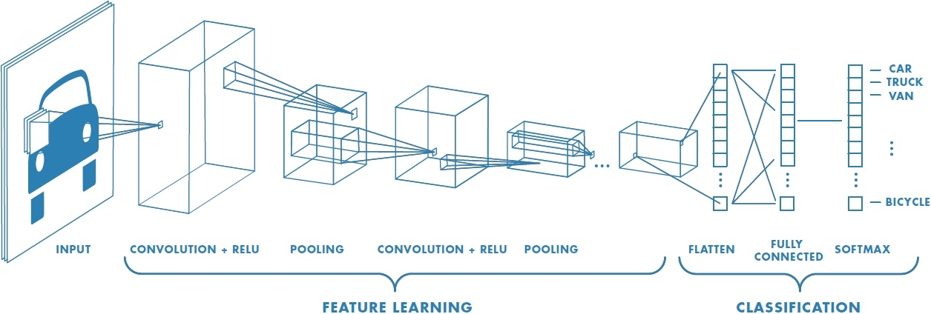
Convolutional Neural Network(CNN)

Slide 5
Convolutional Neural Network(CNN)
In CNN, the image is fed to the network.
Then, the filters of given size are applied and implements the Convolution.
The obtained features then go through the Activation Function. Then, the output goes through a succession of pooling and other convolution operations.
Features dimensions are reduced as the network goes on.
At the end, these features are flattened and fed to fully connected layers, which calculates the class probability when sent through Softmax layer.
During this training time, the network learns how to recognize the features.

Slide 6
What’s wrong with Convolutional Neural Network ?

Slide 7
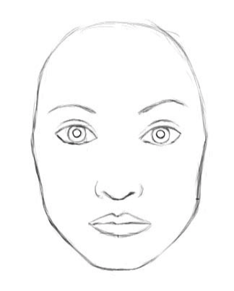
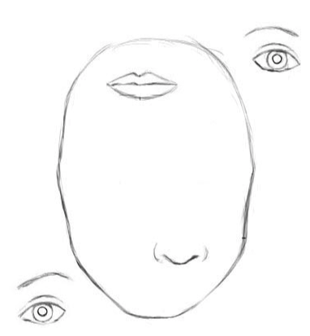
What’s wrong with Convolutional Neural Network ?
To a CNN, both pictures are similar, since they both contain similar elements.

Slide 8
What’s wrong with Convolutional Neural Network ?
There are two reasons behind the failure of the CNN.
Max Pooling:
The Max Pooling throws away the precise position of the entity within the region.
Flattening of the features:
The flattening of the features results in the loss of the spatial relationship between the objects which are present in the region.
So, the CNN only search for the objects in the image but do not checks the spatial arrangement of these object with respect to each other.

Slide 9
Invariance vs Equivariance
Invariance
Invariance is the property due to which there is no change in the neural activity when there is a change in viewpoint.
So, CNN are invariant.
Equivariance
Equivariance is the property due to which there is change in neural activity also when there is a change in the viewpoint of the object.
We want to achieve equivariance in Capsules Network.

Slide 10
Capsules Network comes to the Rescue

Slide 11
What are Capsules ?
A Capsule is a group of neurons whose activity vector represents the instantiation parameters of a specific type of entity such as an object or an object part.
Every neuron inside a Capsule represents various properties of a particular entity that is present in the image.
These properties may include many different types of parameters such as position, size, orientation, velocity, texture etc.
If there is a 6-dimensional capsule, that means there are 3 neurons inside that capsule with different values, would be like:
[11 23 6 17 2 23], the values inside are activation values of the respective neurons.

Slide 12
Dynamic Routing Between Capsules
Hinton argues that, the brain identifies the images by the reverse of rendering.
Rendering is the process of creating an image from the 2-D or 3-D model using the rendering softwares.
He calls it inverse graphics: from visual information received by eyes, they deconstruct a hierarchical representation of the world around us and try to match it with already learned patterns and relationships stored in the brain. This is how recognition happens. And the key idea is that representation of objects in the brain does not depend on view angle.
The Capsule Network helps in fetching the instantiation parameters of the object present in the image to implement the inverse graphics.

Slide 13
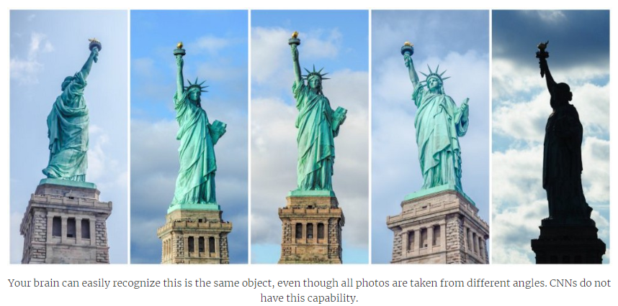

Slide 14
Architecture of the Capsules Network

Slide 15
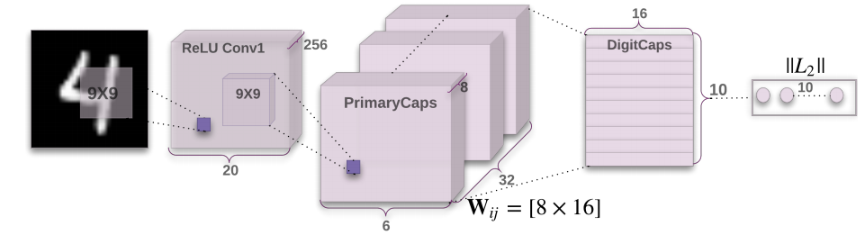
Architecture of the Capsules Network

Slide 16
Layers in a Capsules Network
Part1: Encoder
Layer1: Convolutional Layer
Layer2: PrimaryCaps Layer
Layer3: DigitCaps Layer
The Dynamic Routing takes place between PrimaryCaps Layer and the DigitCaps Layer.
Part2: Decoder
Layer4: Fully Connected #1
Layer5: Fully Connected #2
Layer6: Fully Connected #3

Slide 17
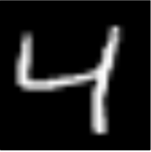
Going Deep into the Capsule Network
Layer1: Convolutional Layer
This is the first layer, where the image is input into the Network.
convolution
256 filters [9 x 9]
1 stride
20
256
[28 x 28]
20

Slide 18
Going Deep into the Capsule Network
Layer2: PrimaryCaps Layer
This is the second layer where 256 feature maps are convolved with 1 filter of dimensions 9 x 9 with 2 strides to produced 256 feature maps of 6 x 6 dimensions.
convolution
[9 x 9]
2 strides
20
6
256
256
6
20

Slide 19
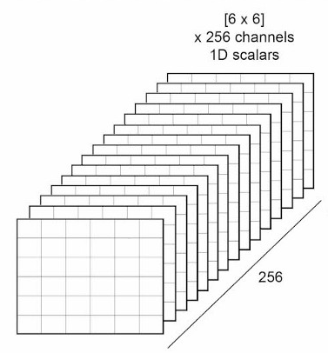
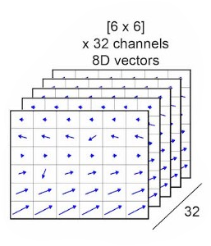

Going Deep into the Capsule Network
Layer2: PrimaryCaps Layer(Contd…)
Now in this layer, [6 x 6] x 256 channels Scalars are reshaped into 8-D Vectors of [6 x 6] x 32 channels.

Slide 20
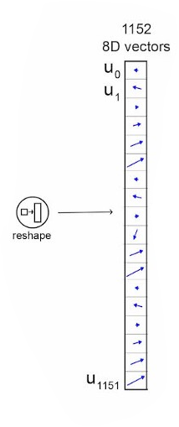
Going Deep into the Capsule Network
Layer3: DigitCaps Layer
This is the layer where Dynamic Routing takes place.

Slide 21
Going Deep into the Capsule Network
Layer3: DigitCaps Layer (Contd…)
Now u of dimensions [1152 x 8] is multiplied with Weight matrix of dimension [8 x 16].
Weight Matrix: Weight Matrix is the Affine Transformation Matrix which will help in identifying the spatial relationship between the objects which are present in the image.
There will be same number of Weight Matrices as the number of classes are there in the Network.
So, in the present scenario there will be 10 Weight Matrices as there are 10 digits to identify from 0 to 9.
When u will be multiplied with W, we will get u_cap of dimensions [1152 x 16]

Slide 22
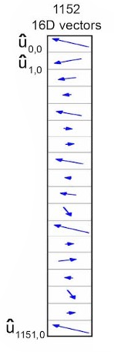

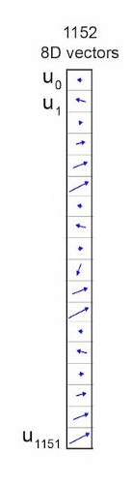
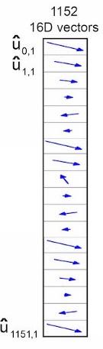
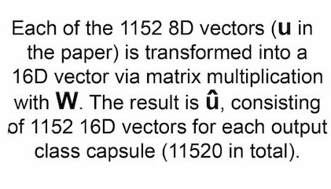


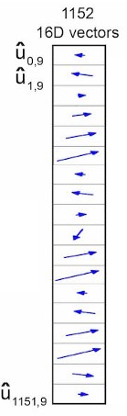


Slide 23
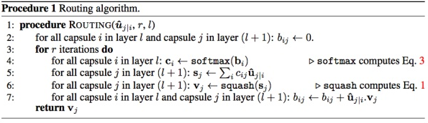
Going Deep into the Capsule Network
Layer3: DigitCaps Layer (Contd…)
Now we have got our 10 u_cap vectors. We are ready to implement the Dynamic Routings.

Slide 24
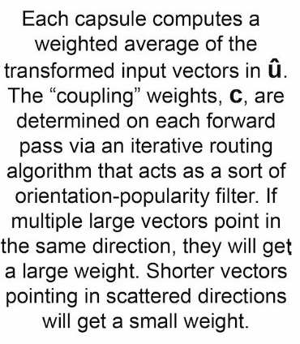
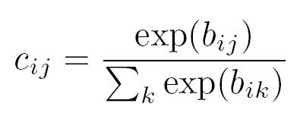
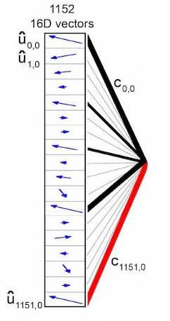
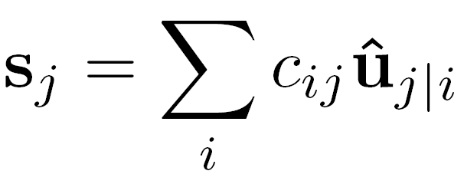
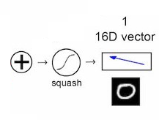
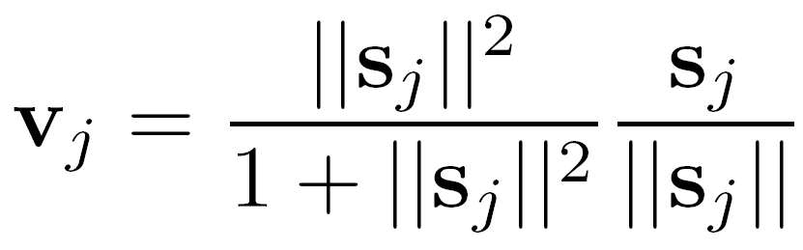
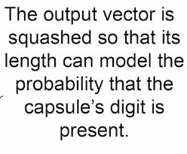
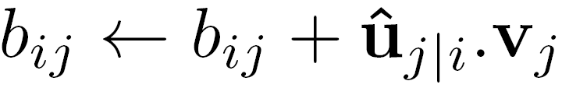
Dynamic Routing Between Capsules

Slide 25
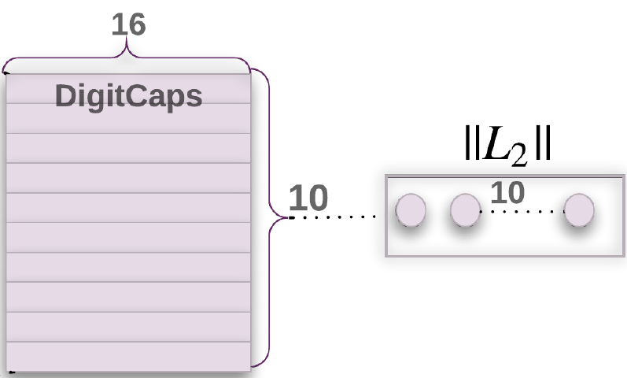
DigitCaps Layer
Now, the routing algorithm is completed and we got our final vectors of dimensions [10 x 16].
L2 is L2 Norm to calculate the magnitude of the vectors.
L2 can be calculated as the square root of the sum of the squared vector values.

Slide 26
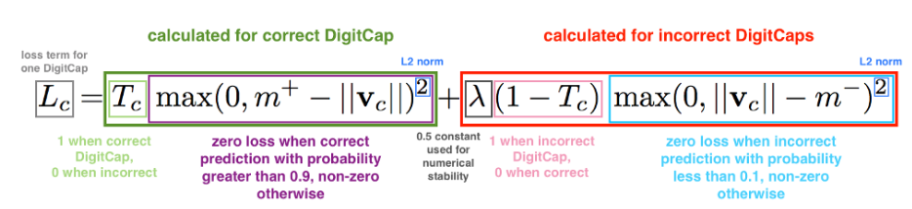
The Loss Function
We know that the DigitCaps layer is 10 sixteen-dimensional vectors.
During training, for each training example, one loss value will be calculated for each of the 10 vectors according to the formula below and then the 10 values will be added together to calculate the final loss.
Because we are talking about supervised learning, each training example will have the correct label, in this case it will be a ten-dimensional one-hot encoded vector with 9 zeros and 1 one at the correct position.
In the loss function formula, the correct label determines the value of Tc: it is 1 if the correct label corresponds with the digit of this particular DigitCap and 0 otherwise.

Slide 27
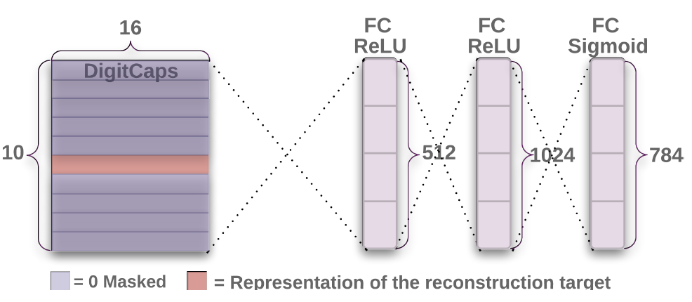

Part2: Decoder

Slide 28
Decoder
Decoder takes a 16-dimensional vector from the correct DigitCap and learns to decode it into an image of a digit
(Note: It only uses the correct DigitCap vector during training and ignores the incorrect ones).
Decoder is used as a regularizer, it takes the output of the correct DigitCap as input and learns to recreate an 28 by 28 pixels image, with the loss function being Euclidean distance between the reconstructed image and the input image.
Decoder forces capsules to learn features that are useful for reconstructing the original image. The closer the reconstructed image to the input image, the better.

Slide 29
Types of Problems which can be solved with Capsule Network

